Slide 1

Even more
Michal Špaček www.michalspacek.com

Slide 2
Recap
New stuff

Slide 3
Recap
(C) INSERT
New stuff
(R) SELECT
(U) UPDATE
(D) DELETE

Slide 4
Create – INSERT
INSERT INTO table (name, city) VALUES ('John', 'Prague');
INSERT INTO table (name, city) VALUES ('Jack', 'NYC');
INSERT INTO table (name, price) VALUES ('submarine', 123456789);
INSERT INTO table (name, price) VALUES ('pizza', 1000000);

Slide 5
In PHP – PDO, PHP Data Objects – INSERT
// If not connected already $pdo = new PDO('mysql:host=localhost;dbname=...;charset=utf8', $user, $pw);
$stmt = $pdo->prepare('INSERT INTO … (…, …) VALUES (?, ?)');
$stmt->execute(array($_POST['name'], $_POST['city']));

Slide 6
Read – SELECT
SELECT name, city FROM table;
(SELECT * FROM table;)
SELECT name, city FROM table WHERE name = 'Jack';
SELECT name FROM table WHERE name = 'Jack' AND city = 'NYC';

Slide 7
In PHP – SELECT
// If not connected already $pdo = new PDO('mysql:host=localhost;dbname=...;charset=utf8', $user, $pw);
$stmt = $pdo->prepare('SELECT name, city FROM table');
$stmt->execute(); // No question marks in prepare(), no array in execute()
foreach ($stmt as $row) {
echo htmlspecialchars($row['name']).htmlspecialchars($row['city']).'<br>';
}

Slide 8
In PHP – SELECT … WHERE
// If not connected already $pdo = new PDO('mysql:host=localhost;dbname=...;charset=utf8', $user, $pw);
$stmt = $pdo->prepare('SELECT name, city FROM table WHERE name = ?');
$stmt->execute(array($_GET['name']));
$row = $stmt->fetch();
echo htmlspecialchars($row['name']) . htmlspecialchars($row['city']) . '<br>';

Slide 9
In PHP – SELECT … WHERE
$stmt = $pdo->prepare('SELECT city FROM t WHERE name = ' . $_GET['name']);
BOOM YOU'RE FUCKED
SQL Injection

Slide 10
Update – UPDATE
UPDATE table SET price = 12345 WHERE name = 'pizza';
UPDATE table SET price = 12345, name = 'capri' WHERE name = 'pizza';

Slide 11
Update – UPDATE
UPDATE table SET price = 12345;
BOOM YOU'RE FUCKED

Slide 12
In PHP – UPDATE
// If not connected already $pdo = new PDO('mysql:host=localhost;dbname=...;charset=utf8', $user, $pw);
$stmt = $pdo->prepare('UPDATE table SET name = ?, city = ? WHERE id = ?');
$result = $stmt->execute(array($_POST['name'], $_POST['city'], $_GET['id']));
if ($result) {
echo 'updated';
}

Slide 13
Delete – DELETE
(DELETE FROM table WHERE name = 'pizza';)
DELETE FROM table WHERE id = 123;

Slide 14
Delete – DELETE
DELETE FROM table;
BOOM
YOU'RE FUCKED
HARD

Slide 15
In PHP – DELETE
// If not connected already $pdo = new PDO('mysql:host=localhost;dbname=...;charset=utf8', $user, $pw);
$stmt = $pdo->prepare('DELETE FROM table WHERE id = ?');
$result = $stmt->execute(array($_POST['id']));
if ($result) {
echo 'deleted';
}

Slide 16
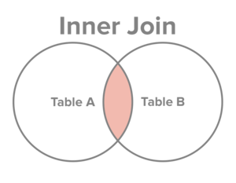
SELECT … FROM table1 t1 JOIN table2 t2 ON t2.key = t1.id

Slide 17
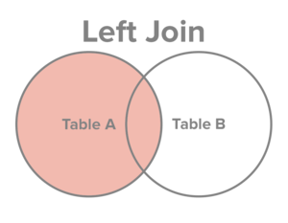
SELECT … FROM table1 t1 LEFT JOIN table2 t2 ON t2.key = t1.id

